Slide 1






Capability deck
O365 - Flow, Forms & Power BI
Flow
Power BI
Forms
April 30, 2019

Slide 2


Global Toy Manufacturer
Business Objectives
HCL Solution
Customer Benefits
SharePoint lists normalized to meet the scalability
PowerApps forms were used for intuitive UI creation
Tabs were added to PowerApps for improving usability
Multiple forms driven by different data sources were provisioned
Custom data-cards were added to the OOB PowerApps forms to meet the business needs
Created custom popups to show the confirmation messages
Created dynamic table to input multiple data values
Custom CSS
Custom validations and business logics
Showing all related information on a single screen.
Business has the scalability to associate multiple resources with the single request
Ability to generate reports for different dimensions
Provisioning of automated standard template for generating/printing of SOW boosted efficiency and transparency
Now they can view all the related requests and their status easily and are more structured
An existing application offering the following needed modernization:
  Capacity Request – resource request submission
  PO – resource Purchase Order
  SOW – Statement of work
  CF – Change form for the extension of previous PO
Manageability issues due to all requests being managed in a singe 50 columns SharePoint list
Manual Status Check
Manual duplicates management
Limit of 10 resources for a request
Complex InfoPath form with readability issues
Manual maintenance of related requests
Technologies Leveraged
Power Apps, O365,Power BI, Microsoft Flow

Slide 3
Danish Brewing Major - 1 of 2
Business Objectives
HCL Solution
Customer Benefits
The purpose of the SharePoint site is to provide a global solution for handling of non-conformities registered during various types of Audits or evaluations.
A user enters the SharePoint form and start registering data under the “Non-conformance registration” tab strip. After entering the data on the registration tab strip the NC should be saved. In principle all fields can be filled in initially. Not until the user have registered data in all required fields can the NC be saved.
The person registered as responsible enters a number of actions – corrective and preventive – in order to indicate the immediate actions.
If there is agreement on the fact that a root cause analysis is to be conducted, then the fields on the root cause analysis screen is filled out.
This activity can have the consequence that additional corrective or preventive actions have to be performed.
PowerApps – One PowerApps apps were developed. PowerApps application solution for handling of non-conformities registered during various types of Audits or evaluations i.e. Local Audit, External Audit,EHS Audit, ManTech Audit, Group quality Audit,COM Self-Assessment consulting visit.
Microsoft Flow – Many flows were built to send notifications and reminders for business reps to take actions when certain events occur (e.g. the overall trigger of the sending of emails is the saving of the NC. Then based on combinations and values of different fields emails are sent to specific roles.). Some of these are triggered from the apps( i.e. for unique permission based on the criticality), others execute automatically based on external events.
Unified database allows detailed analysis on audit performance which was not possible before
Can ensure audit reps are focusing on the most important assign reports
~16 hours saved per month per audit rep, using the app is quicker than excel and email
No more searching through emails; considerable time savings for supervisors
Everyone stays up to date through automated emails and notifications via Flow
Record discretion and privacy maintained for group of users.
Easy for reporting and performance.
~10 times faster process for correction and prevention steps and closer for audit item
Technologies Leveraged
O365, MS Flow, Power Apps

Slide 4
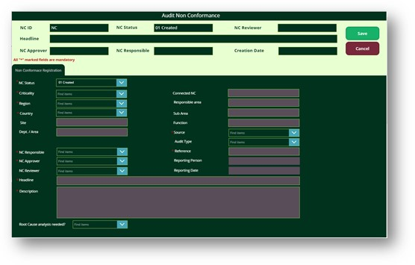
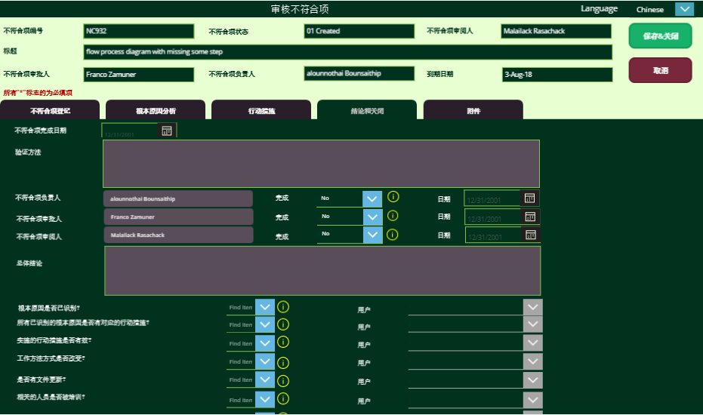
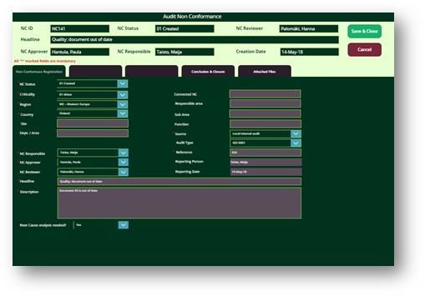
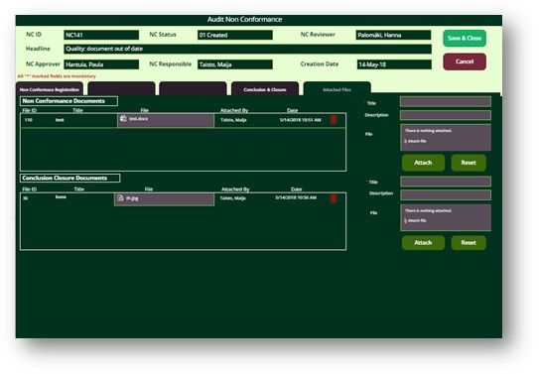
Danish Brewing Major (Snapshots)

Slide 5
Danish Brewing Major - 2 of 2
Business Objectives
HCL Solution
Customer Benefits
Microsoft Forms – MS Forms were leveraged to full fill the survey requirement. Admin can create multiple surveys for different trainings and can view the results in excel with some more details like logged in user email id, date when he/she completed the survey, how much time he/she took to fill the survey, along with the answers of survey. This result gets saved in personal one drive of admin and can be accessed anytime. Also, with many other settings of MS Forms like – make this survey available to users within organization or anonymous access is permitted – Admin can completely handle its usage.
Microsoft Stream – MS Stream was used to upload the training videos with in Groups, so that no unauthorized user access or share the video. It also gives flexibility to add thumbnail/cover image of the video.
Once form was created and video was uploaded, both were merged using OOB web parts – MS Stream and Microsoft Form, on single page of SPO to provide the solution of requirement.
For end user, a dashboard was created from where links to training page are available. This dashboard was created using list view web part of Links type of list.
Unified type of training pages.
Survey response can be exported to excel which make it easy for analysis purpose
Survey response captures all relevant information of logged in user like email id and date time when survey was completed.
Admin can configure survey to get notification every time a user completes a survey.
Admin can share survey template if require within the organization, so that someone else can also set up a survey on his behalf.
End user gets the training video and attendance survey, both on same page, which makes it user friendly.
The requirement was to provide OOB training pages in SharePoint Online, where a video is shown of the webinar for training purpose and logged in user needs to fill up a survey to mark his/her attendance.
All this should be done on a single page to save multiple clicks or navigation.
Admin should be able to share the link of page with appropriate audience.
Videos should be uploaded at a place where no unauthorized person can view or share them.
Survey report should be available to Admin of the survey only
Technologies Leveraged
O365, MS Forms, MS Steams

Slide 6
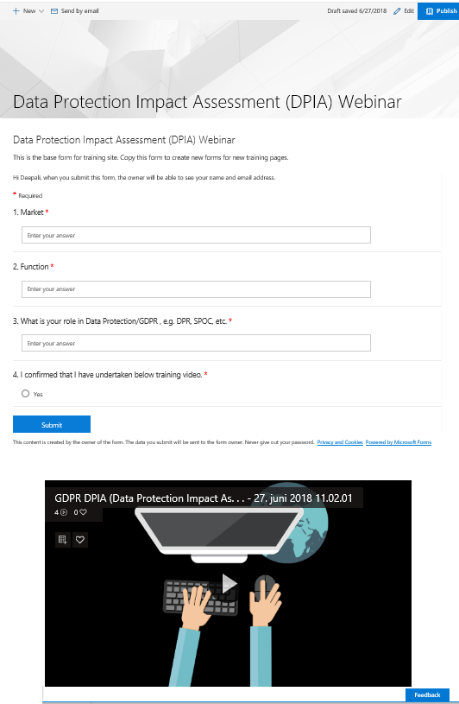
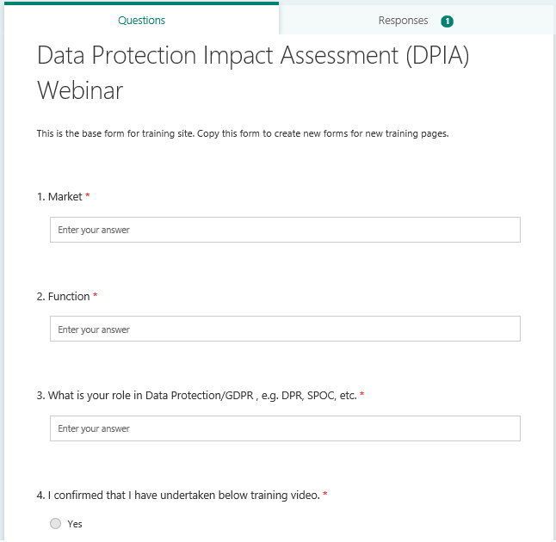
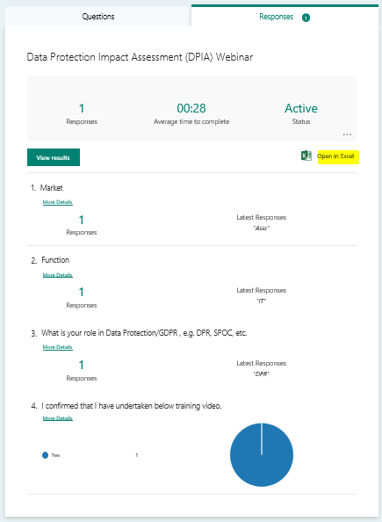
Danish Brewing Major (Snapshots)

Slide 7
American Multinational Elevator Company
Business Objectives
HCL Solution
Customer Benefits
No consistent interface for customer segmentation reports.
Customer Segmentation logic is exist in Microsoft Access database which is not so powerful to meet ongoing report requirements.
Existing Legacy model not helps to extend the data & logic model to adapt new sources dynamically.
Analytic models are not exist in current solution which cause to miss the predictability of cancel & Resign contracts
Widening of ETL window and resulted delays were also impacting the downstream users which were dependent on them.
Currently Data fresh happens quarterly in which the customer wants to happen Monthly
Currently all the reporting is done in excel
Need to store Old data in Excel for any reference
HCL provided End to End development and maintenance support for implementing Customer segmentation of data from large number of upstream applications.
Solution is implemented with Operational and Security Framework.
To provide the Reports with accurate data on a timely basis for Regional & Branch Managers and Sales across regions in NAA location.
Enable the reporting solution as Self Service BI to business users with POWER BI with Azure Active Directory for security and Dynamic RLS
Azure SQL Server should contain Non revenue data only as per the Business requirement
SSIS ETL framework for Data Processing
On Premise to Azure SQL server data is been moved by Azure Data Factory by having intermediate as Azure Table Storage
Quick analysis of customer revenue, margin & value data by excel & Power BI reports
Scalable application to integrate multiple internal/ external sources
Scalable application to Monthly Load from current Quarterly Load
Automated the Dynamic RLS Capability in Power BI reports and Maintaining the Security of Access of reports with AAD and Power Shell
End to end traceability through a metadata management (Operational Framework)
Predicting customers further value and planned cancel contracts to take preventive actions to contract renewal
Technologies Leveraged
Power BI & Excel – Reporting
(SQL Server, Azure SQL Server) – Database
Azure Table Storage -- Intermediate
SSIS & Azure Data Factory - ETL
Azure Active Directory – Security

Slide 8









American Multinational Elevator Company- Solution Architecture
On Premise
Azure
Reporting
Azure Active Directory
CRM
Engineering
Azure Data Factory
Azure Data Factory
Data staging
Customer Segmentation
Security Access(Report, RLs)
Revenue
SSIS
SSIS
Data Staging
Power BI
CBENRM
Azure Table Storage
Azure SQL Customer Segmentation
Risk Data
Customer Network
DMG Gateway

Slide 9
Global Top-Tier Software Product Company
Business Objectives
HCL Solution
Customer Benefits
All LOBs feel a lack of BI capabilities, data and infra that are agile, robust and anticipate business demands
BI siloes pervade, impeding BI talent acquisition, fungibility and growth – 80% functions unique
BI governance is non-existent: portfolio, architectural and data choices left to siloed efforts – 80% data duplication
BI capabilities are limited to “rearview” reporting; no repeatable real-time or analytic insights
BI infrastructure is fragile, non-scalable, and under-invested – 4% of business spend on durable platform
BI delivery relies heavily on slow, costly ad-hoc delivery – 50% of Global BI spend is ad-hoc
Lack of common BI technologies make it difficult to identify, acquire, and integrate required data
Data platform employs Data Lake a hybrid of SQL & Big data stores. Integrated DW using Bus architecture & conformed dimensions
Data Acquisition Platform (DAP) accelerates Data Acquisition. Self-serve reporting capabilities with Business data dictionaries
Certified Managed reports with 30 secs rendering SLA. Agile development providing quick business value to the business
Framework based ETL/ ELT development using MS technologies & development accelerators for rapid development
BI university for end user training
BI on BI – Better user experience for our users, adoption, and internal metrics tracking
Automated environment monitoring & proactive outage communication to business
Clear BI architecture & governance that ensures durable, flexible capabilities and data that anticipates the business need
Agile BI delivery process that accelerates incremental ROI
Enhanced Self-service that empowers the business through discoverable, process-aligned reporting and visualization
Real-time Performance Management that enables granular transparency to the pulse of the business execution Optimization and prediction
Legacy silo data platforms retired with a scalable data mart for each LOB. Huge cost, quality and performance benefits realized.
Single version of truth achieved
Technologies Leveraged
Microsoft SQL Server 2012/2014
SSIS, SSAS, Tabular, Power BI
Cosmos (MS Big Data), SharePoint
VSO, MIST. Azure ML, R

Slide 10

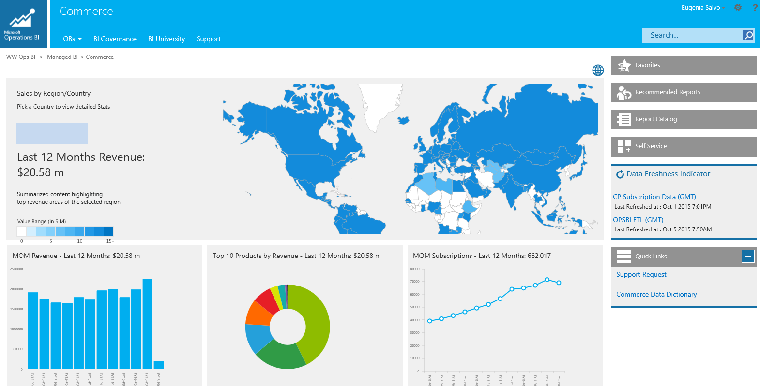
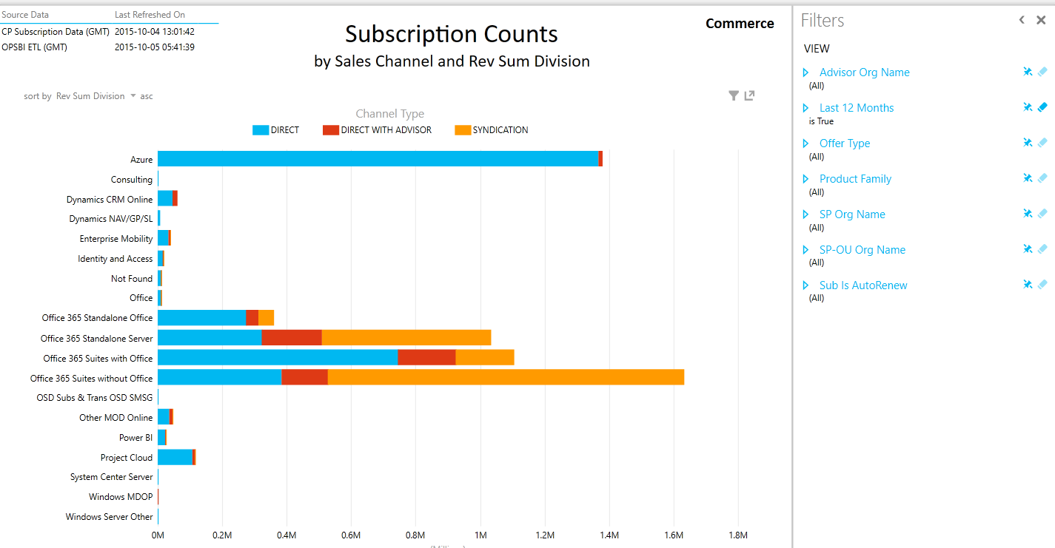
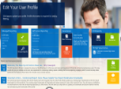


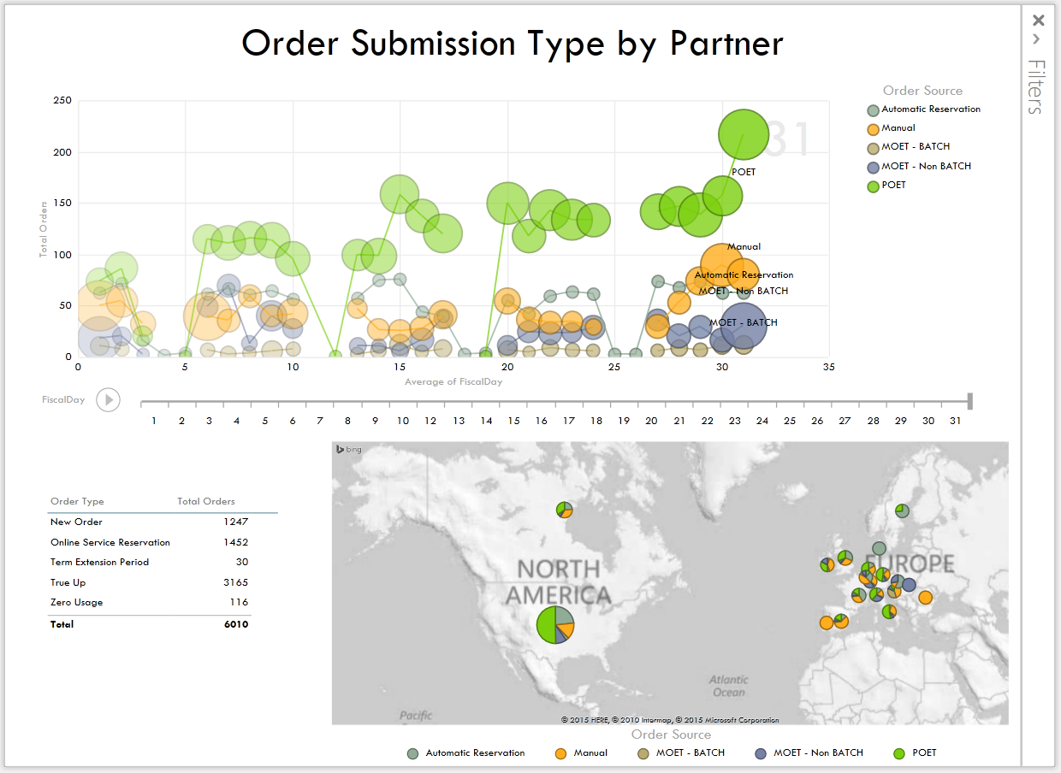
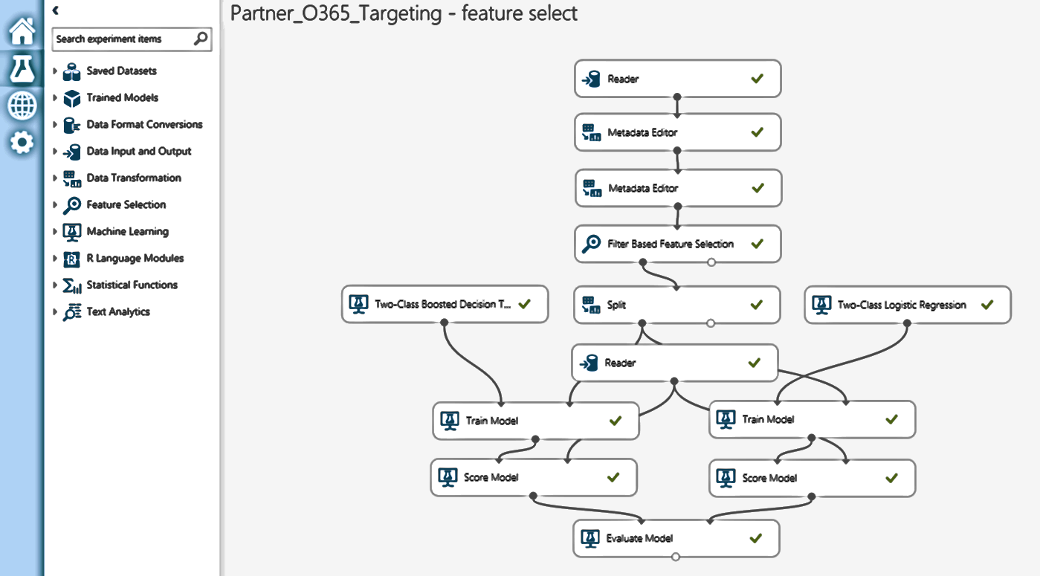

Global Top-Tier Software Product Company - Solution Architecture
Data Acquisition & Integration
Biz Models & Analytics
BI User Interfaces
Self-serve Portal
Data Acquisition Platform (DAP) accelerates Data Acquisition
Management of SQL & Big Data Sources via patterns
Integrated DW using Bus architecture & conformed dimensions
Tabular Models optimized for self-serve.
Biz. Analyst and Power Users Sandboxes
Data Access Security at Row & Column Level
Shared Common Dimensions enables E2E BI
Self-Serve via Power Views & Excel Power Pivots
Biz and Personalized Dashboards via Power BI
Managed Reports with 30 secs rendering SLA
Predictive Analytics using R and Azure ML
Managed & User Created Reports Catalog and Favorites
Secure Access per User Groups.
End User Readiness - BI University
SQL Server Sources
Sales Data
CRM
Agreements
License
EIP
SAP
Commerce
Devices
OEM
NGVL
GESO
Commercial
Big Data
DAP
(Data Acquisition Platform)
…….
Shared Common Dimensions
CP
Apps
FeedStore
OLS/RLS**
Azure Telemetry

Slide 11
Leader in Banking and Capital Markets
Business Objectives
HCL Solution
Customer Benefits
Need to meet the regulatory reporting commitments across various jurisdictions more efficiently and effectively.
Ability to connect different source data from all major trade capture systems.
Need to process more than100 million trade data on daily basis.
Report should be capable of display all complex calculations on real-time with row level security.
Find the missing market data.
What are the risk factor associated for a particular trade, if trade is high or low volume.
No Self Service BI reporting solution
More businesses demand on real-time Analytics and data insight.
HCL is provided End to End development In-Memory Tabular Cube on a Flattened schema for consolidation of data from large number of upstream applications. The primary purpose of the In-Memory Tabular Cube solution is to get the optimal performance and provide the accurate Value at Risk (VAR) data, Hypothetical data, and unexplained data spread across geographical locations and provide many complex calculation data on real time.
Agile development providing quick business value to the business
Framework based ETL/ ELT development using MS technologies & development accelerators for rapid development
BI on BI – Better user experience for our users, adoption, and internal metrics tracking
Better Decision Making: Market Risk Officers, Traders and Valuation Team are now aided by advanced, real-time analytics in their decision-making process.
Lower Cost: Microsoft BI offered much-desired analytical capability, with the required amount of flexibility and security, at a very acceptable cost.
Improved Efficiency: Ability to process up to 100 million trades per day.
Microsoft Power BI: brings visualization of the data insight to users.
Reduced Dependency on IT: Business teams now can own and manage their data without heavy dependency on IT teams.
Technologies Leveraged
SQL Server 2012, SSIS 2012, SSAS Tabular 2012
Power BI Desktop, VS 2015, GitHub

Slide 12
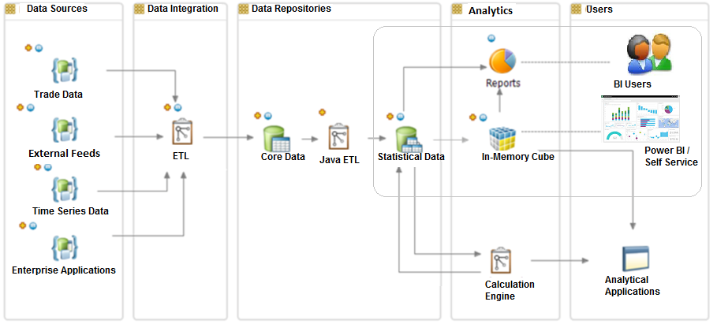
Leader in Banking and Capital Markets - Solution Architecture

Slide 13
Leading Global Pharma Player
Replacement Solution for MS Access DB in SharePoint, PowerApps, MS Flow, PowerQuery tool in Excel
Product Supply Group consists of scientists who has their individual team for product development and research activities
PSG team currently maintaining the day to day activities in MS Access DB with custom forms and custom views
This MS Access DB is stored in shared files and being accessed globally
Current team is facing challenges accessing this access database and they are looking for a solution from IT
Now IT is looking for solution which is available globally and future proof
IT has migrated the data from Access DB to standard SharePoint list
Built custom form in PowerApps
Flow is used to implement business process
PowerQuery tool in EXCEL is used for dashboard
Case Library for Global Legal in SharePoint, MS Flow, Harmon.ie, OneDrive, PowerQuery tool
Global legal is consists of around 40 people from different parts of the world
Each and every team within Legal team used to receive on an average 50 emails per day
They need a solution which will be integrated within the Outlook itself. So that they can archive emails at ease with custom metadata which will be accessible to all team without spamming individual mail boxes
Harmon.ie has been used as an Outlook plugin as an email archival tool which will help to create new case folder with minimal set of metadata
MS Flow has been used for the following activities
Auto case numbering and case folder name cannot be changed once it is assigned
Autofilling of metadata based on user’s profile, this helped legal personel to save their time
Create restricted case folder when the case is created by legal head
PowerQuery tool in excel is used for dashboard

Slide 14
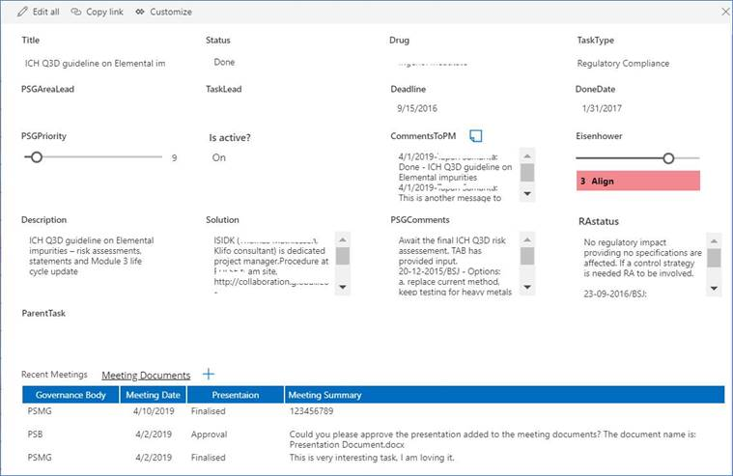
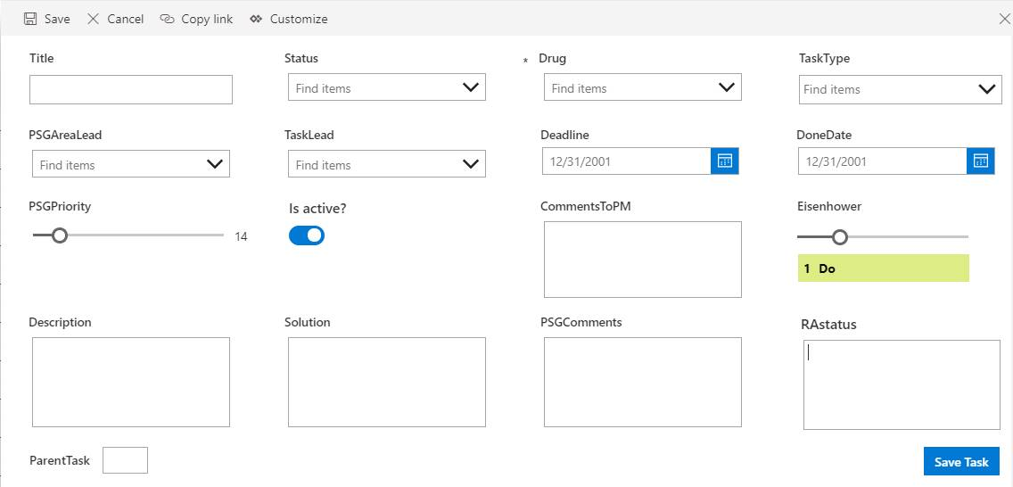
Leading Global Pharma Player (Snapshot)

Slide 15
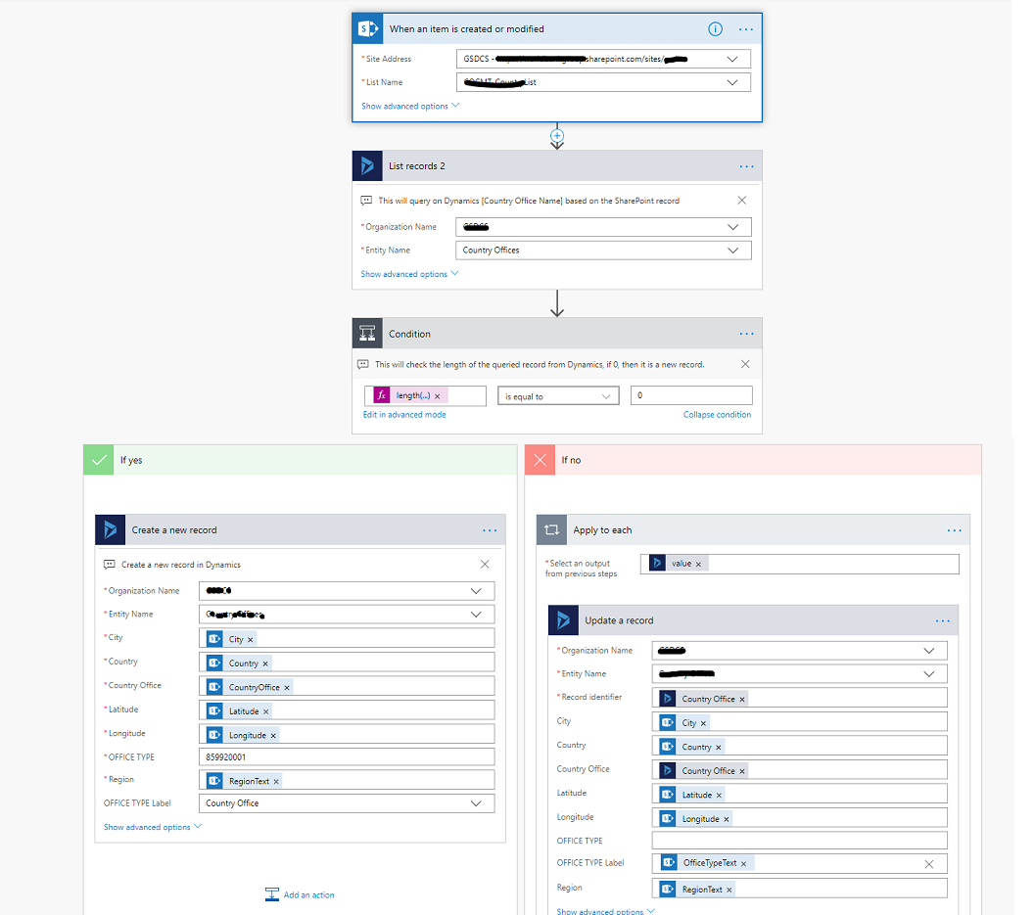
World’s Largest Development Bank
Business Objectives
Sharing data among multiple O365 systems such as MS Dynamics and MS SharePoint
Quick time to development and deployment
No-Code and Low-Code solution

Slide 16
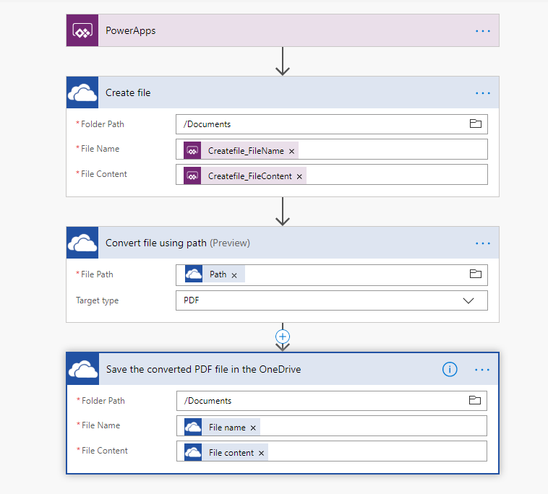
World’s Largest Development Bank
Business Objectives
Business information stored in SharePoint Online and being managed from PowerApps had to be exported in PDF
Exported PDF needed to be saved in Team’s One Drive location.
Quick time to development and deployment
No-Code and Low-Code solution

Slide 17
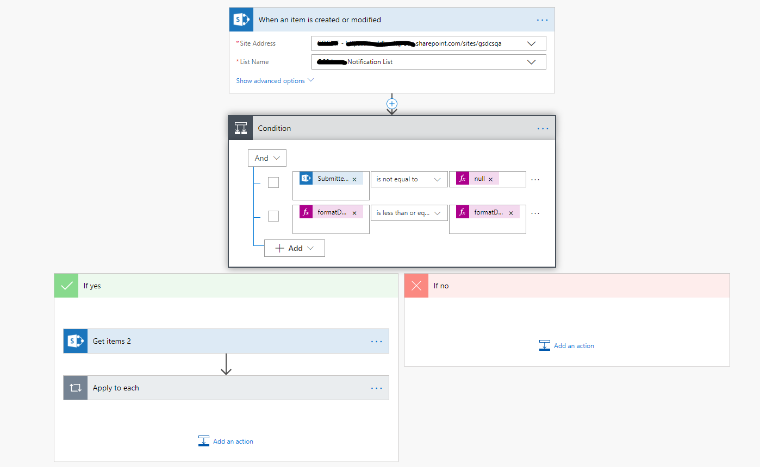
World’s Largest Development Bank
Business Objectives
Business users (at Director level) needed mission critical notification while they are on mission to different countries.
Analysts at HQ would analyze the criticality of the country where the director is travelling from different Office 365 systems and send Push Notification.
Quick time to development and deployment
No-Code and Low-Code solution

Slide 18
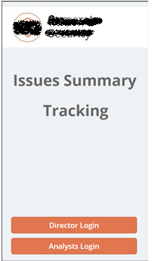
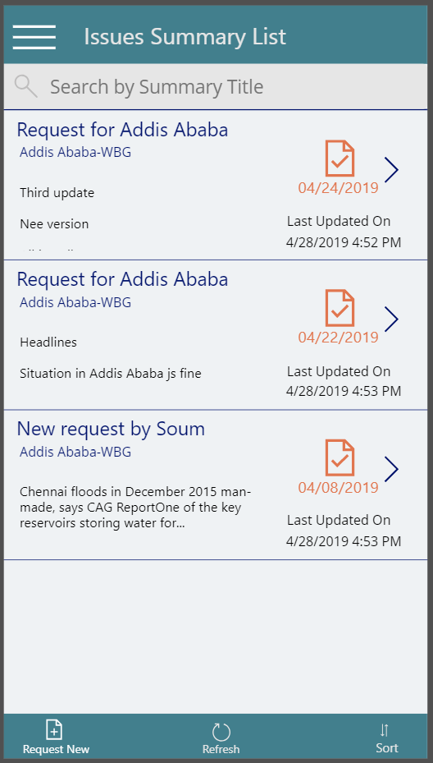
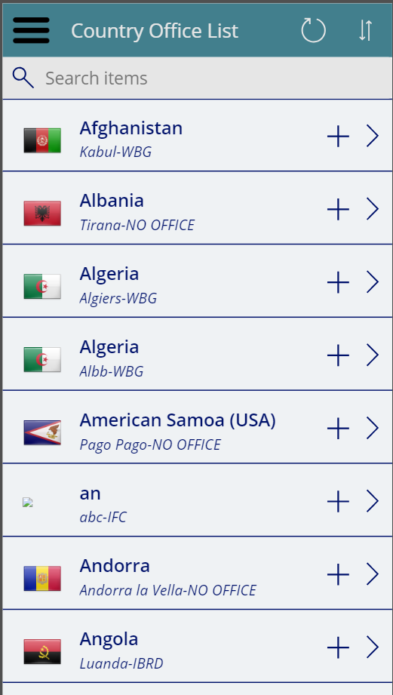
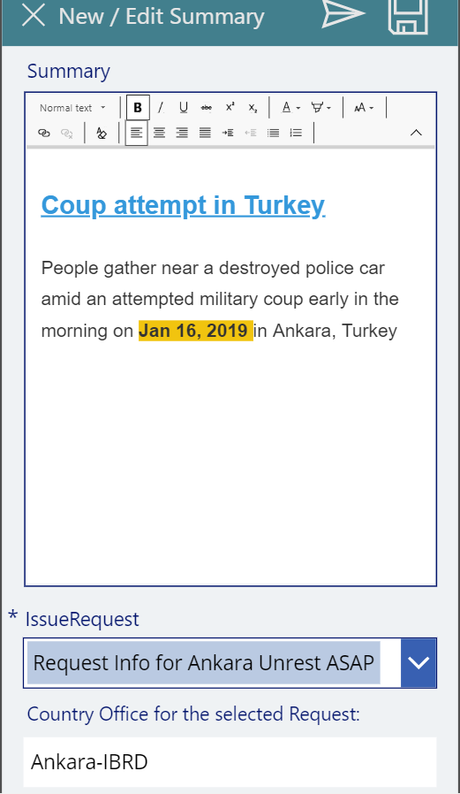
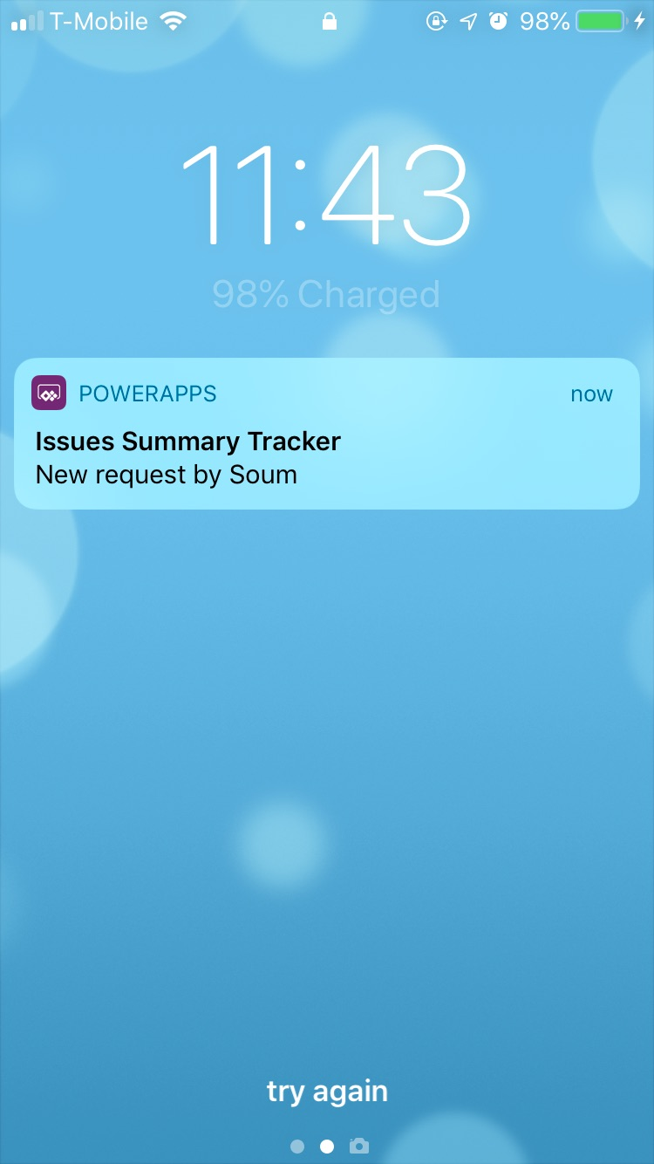
World’s Largest Development Bank
Business Objectives
Senior Directors wanted to get notification on critical notifications in a WhatsApp like fashion
Information related to the notification needed to be collated from various Office 365 systems.
Quick time to development and deployment
No-Code and Low-Code solution

Slide 19
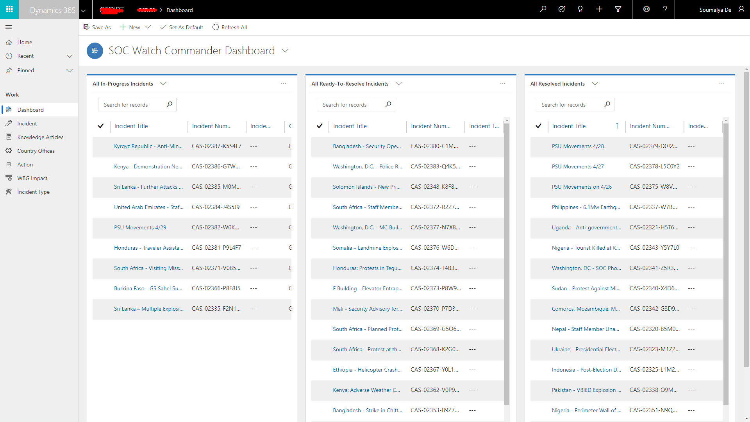
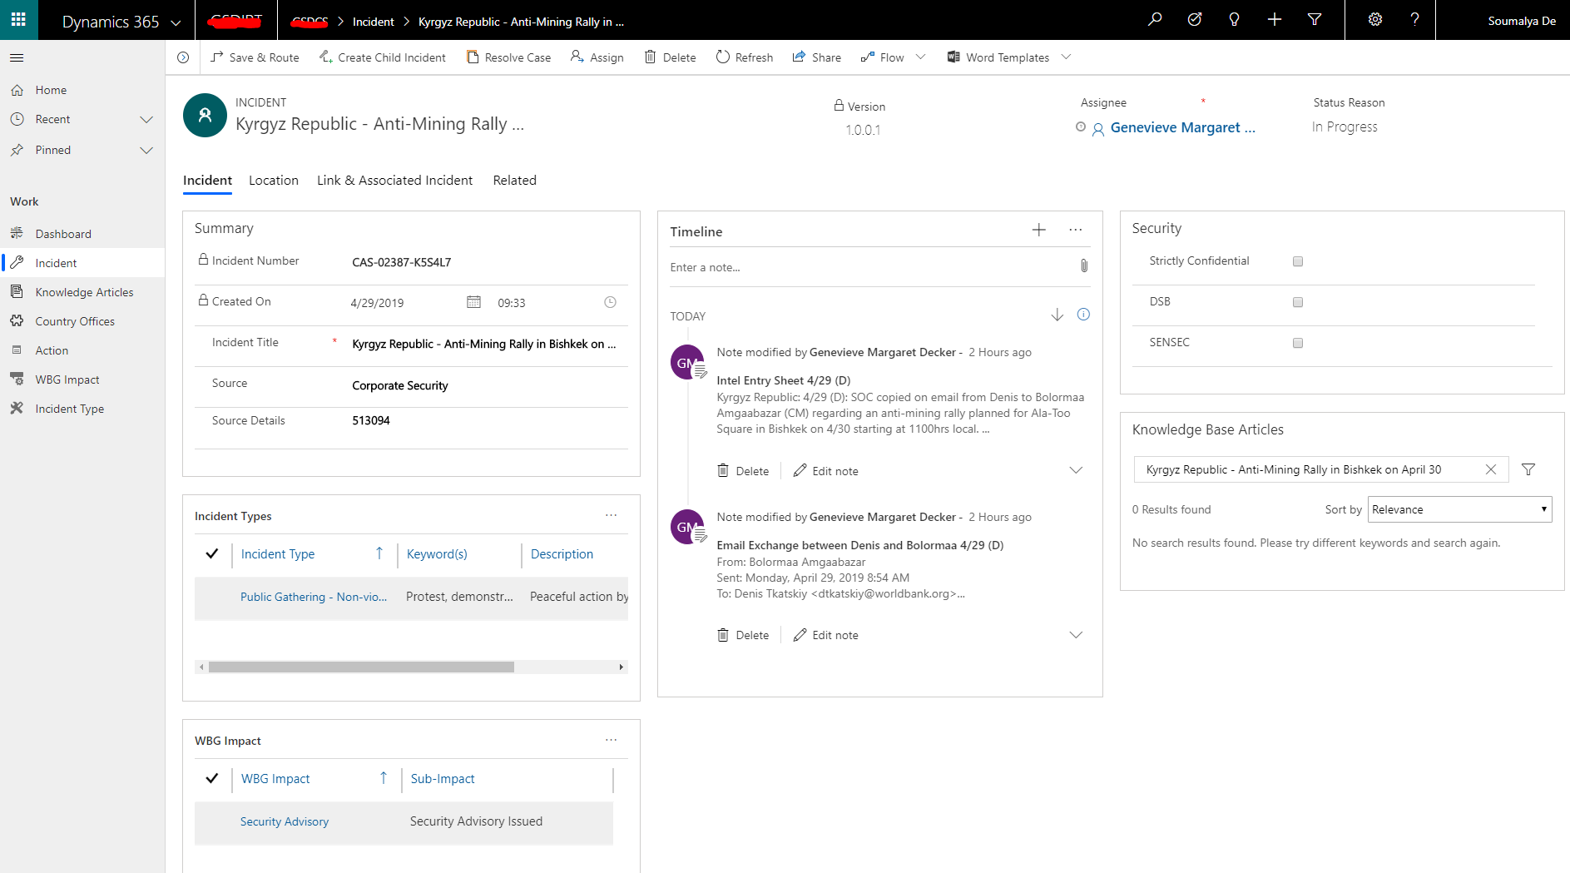
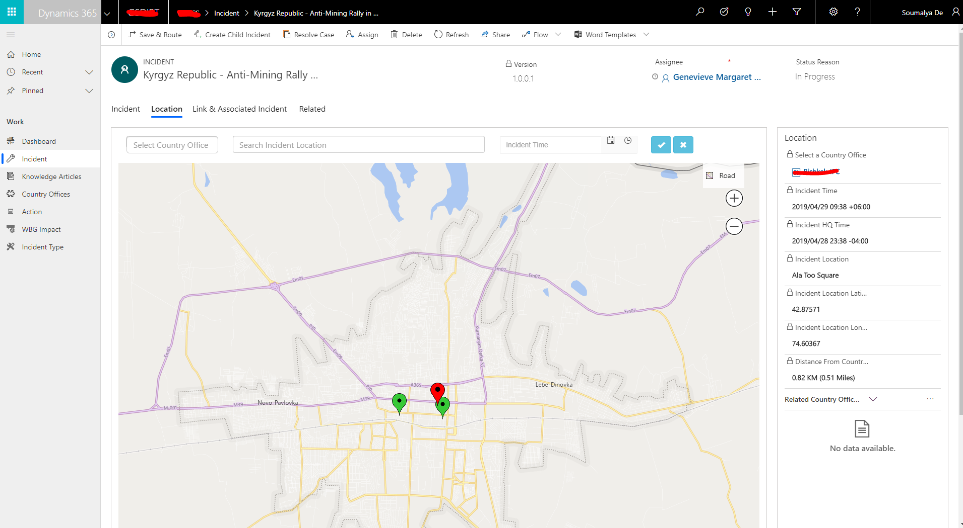
World’s Largest Development Bank
Business Objectives
Sharing data among multiple O365 systems such as MS Dynamics and MS SharePoint
Quick time to development and deployment
No-Code and Low-Code solution

Slide 20
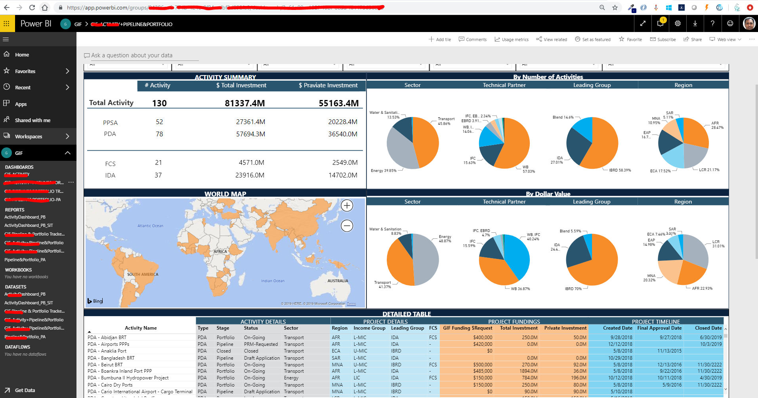
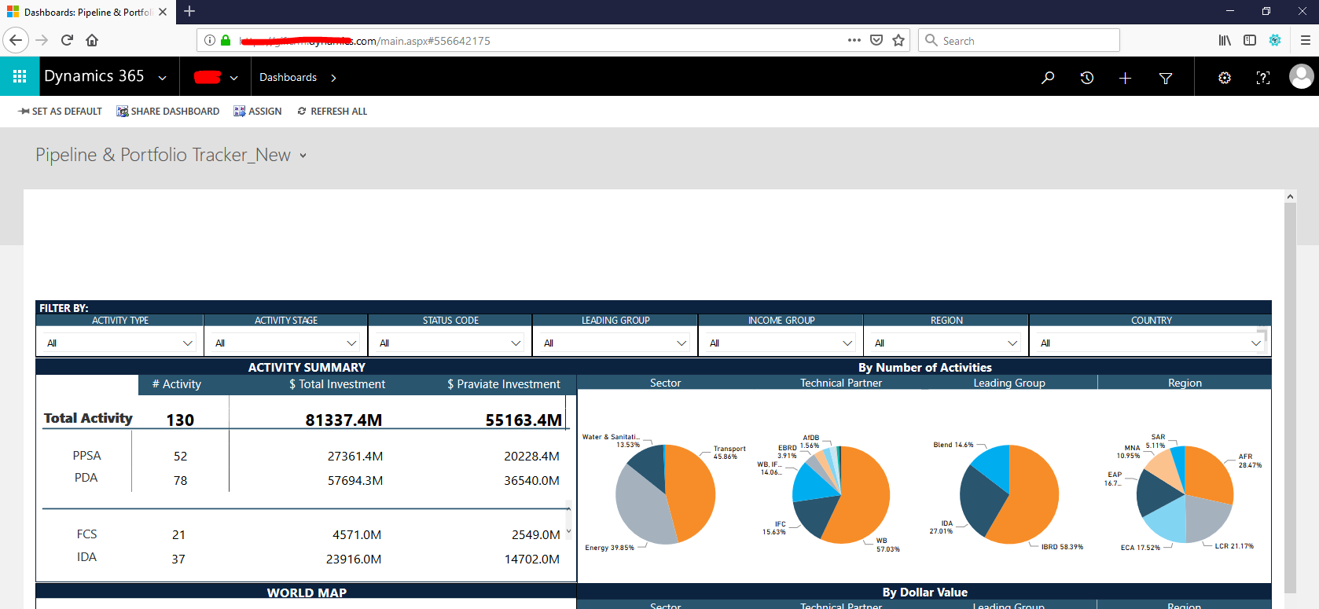
World’s Largest Development Bank
Business Objectives
Business users wanted to build complex graphical reports on an existing MS Dynamics system
Information available in MS Dynamics needed multi level Joins and embedded in MS Dynamics.
Quick time to development and deployment
No-Code and Low-Code solution

Slide 21
Leading Australian Agribusiness Entity
Business Objectives
Audit Flow
Branch Review
Manager Discussion
My Action
Final Review
Audit checklist with 30-35 set of question. Audit checklist classified based on Safety, Compliance and Business Risk.
Option to generate Audit checklist for branch and assigned to auditor
Mail notification
Reports
Technologies Leveraged
Power App- Canvas App to develop UI
O365- Audit App Data Repository
Flow- Store image in SP image Library & Send Email

Slide 22
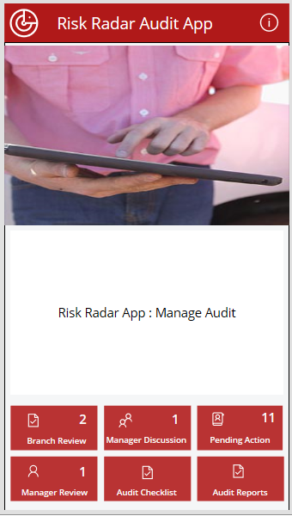
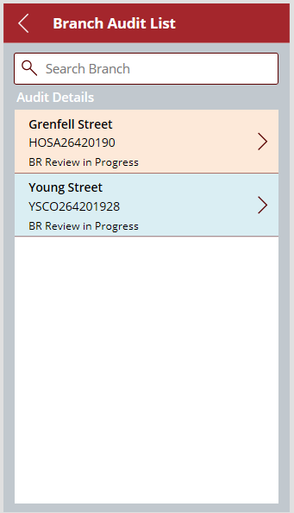
Leading Australian Agribusiness Entity ( Application Screenshots)
Home Page
Audit Search
List the navigation option. Audit checklist option will be available only to Admin. Number in the button list shows pending Audit count.
List all the audit pending for review. On selection of an audit navigate to related audit review screen.

Slide 23
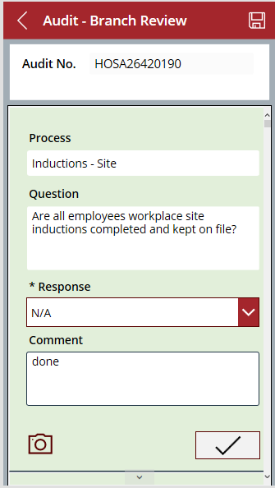
Leading Australian Agribusiness Entity ( Application Screenshots)
Branch Review Screen
Manager Discussion Screen
Auditor review the checklist and update the required details. Response with no option will move to next stage and appear under manager discussion.
Manager Discussion screen list only the audit question with no response. Post manager discussion, action will be assigned to a responsible person and the action will appear in my pending action of the user.

Slide 24
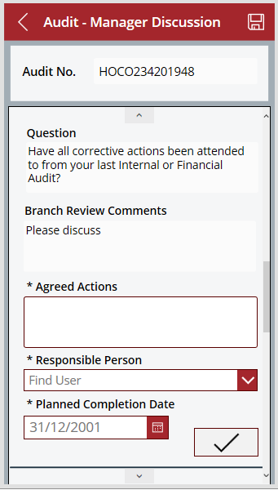
Leading Australian Agribusiness Entity ( Application Screenshots)
Branch Review Screen
Manager Discussion Screen
Auditor review the checklist and update the required details. Response with no option will move to next stage and appear under manager discussion.
Manager Discussion screen list only the audit question with no response. Post manager discussion, action will be assigned to a responsible person and the action will appear in my pending action of the user.

Slide 25
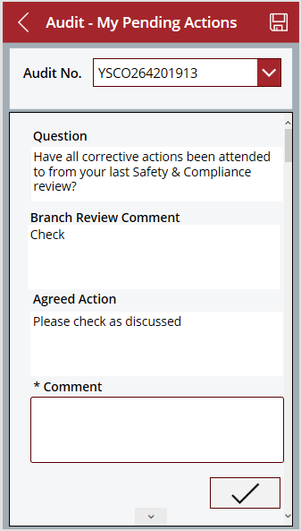
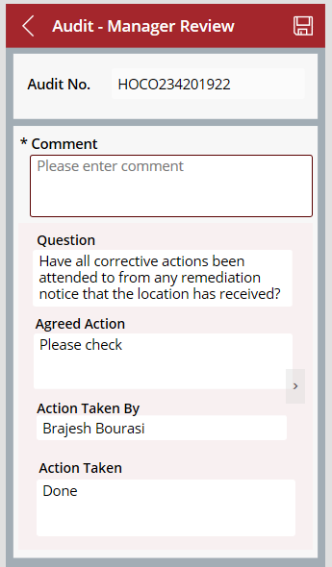
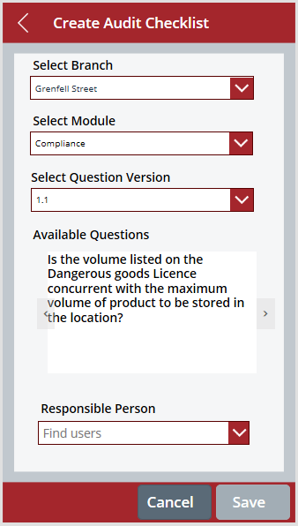
Leading Australian Agribusiness Entity ( Application Screenshots)
Pending Screen Action
Audit Final Review
Create Audit Checklist
List all the logged in user related pending item and provision to update comment. Post completion of all the item, audit will ready for final review by manager.
Manager review the audit and update comment
Create Audit Checklist.

Slide 26

Thank You

